Slide 1
Primeros pasos con sistema de control de versiones
Notes:
https://t.me/CursoGit

Slide 2
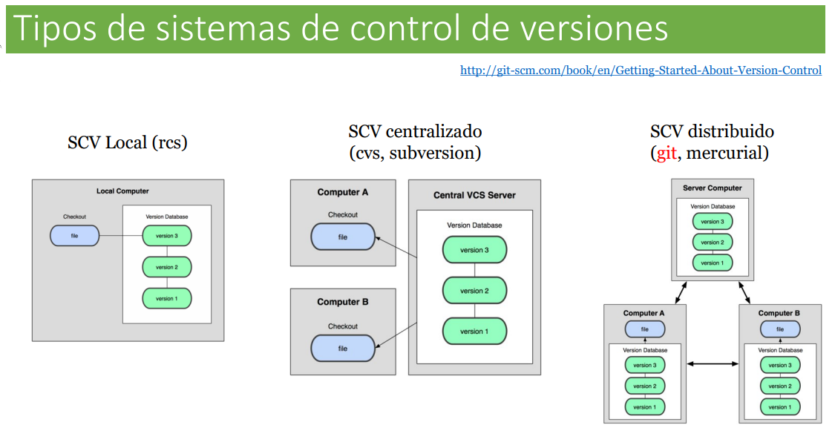

Slide 3
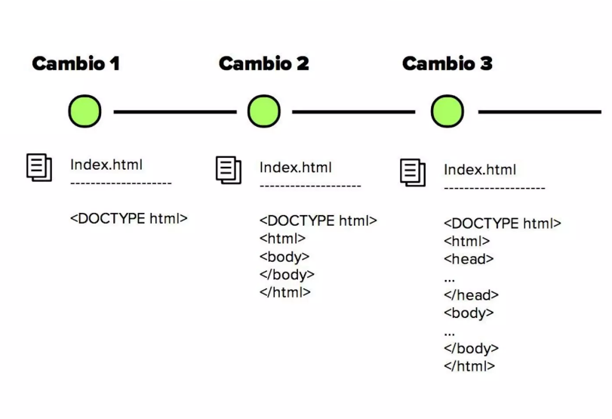
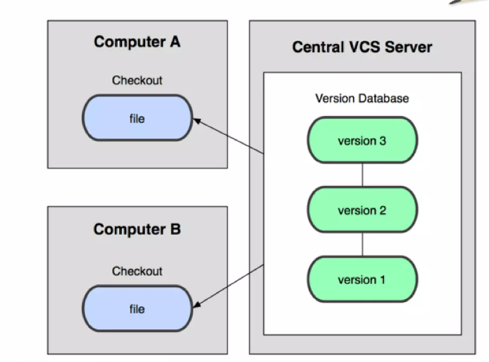

Slide 4
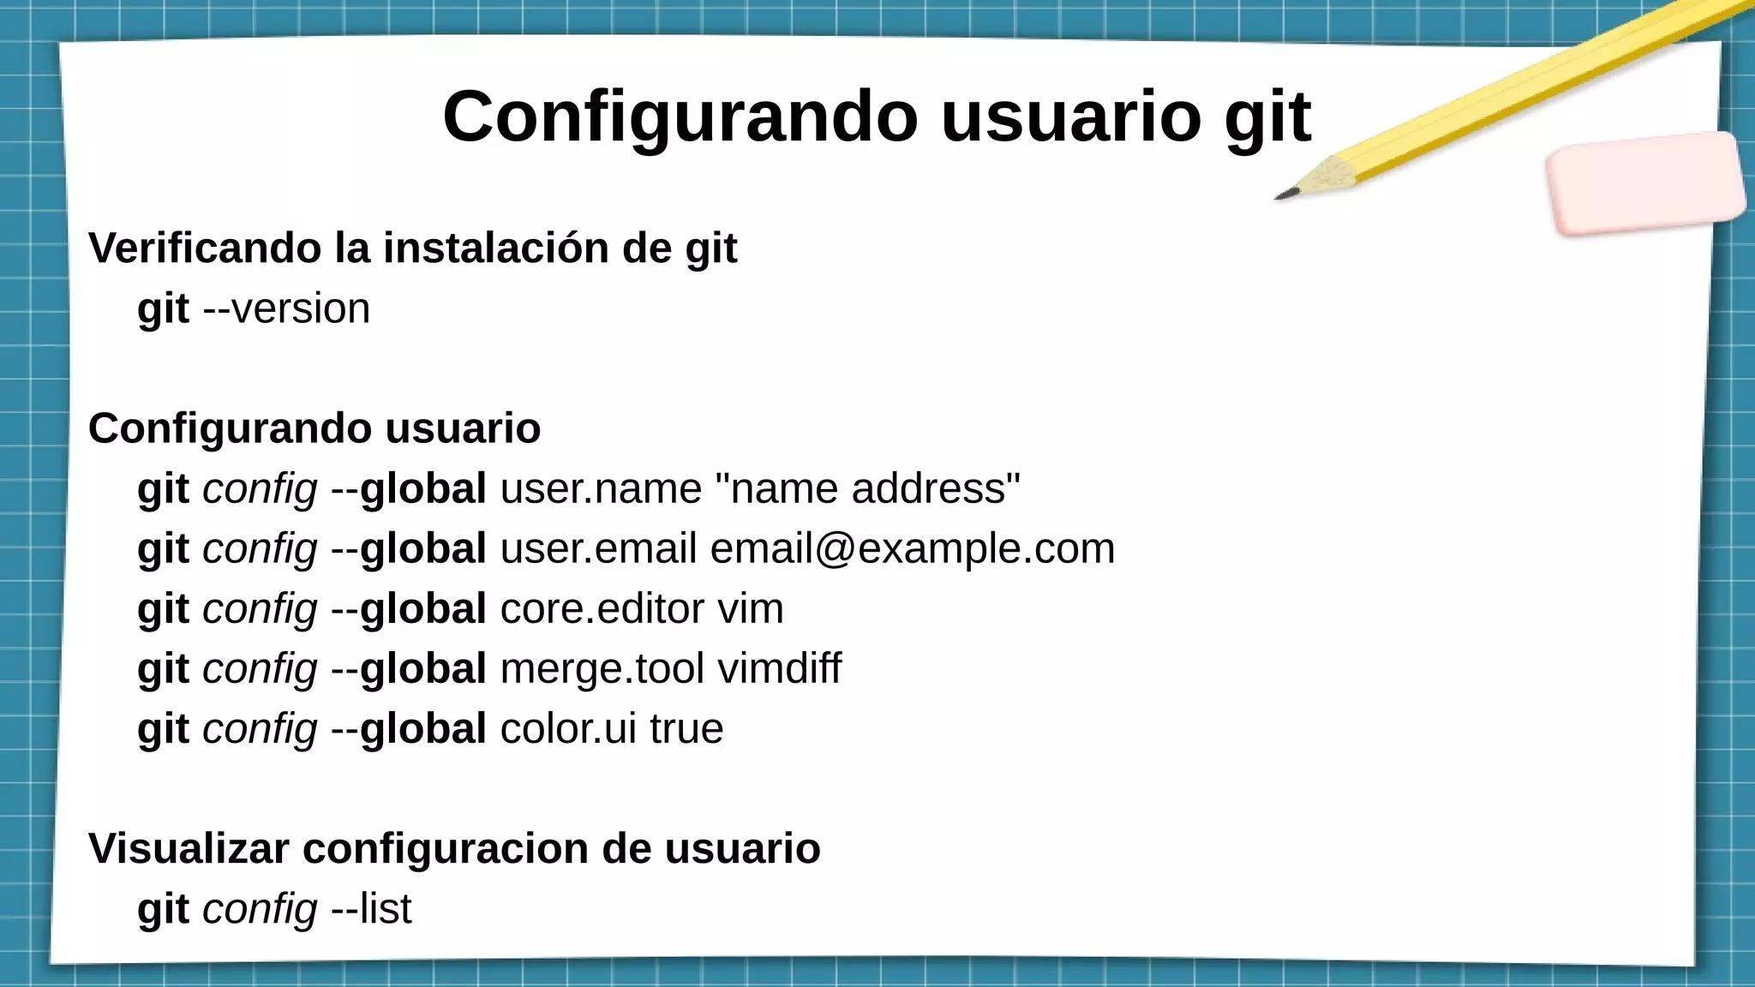

Slide 5
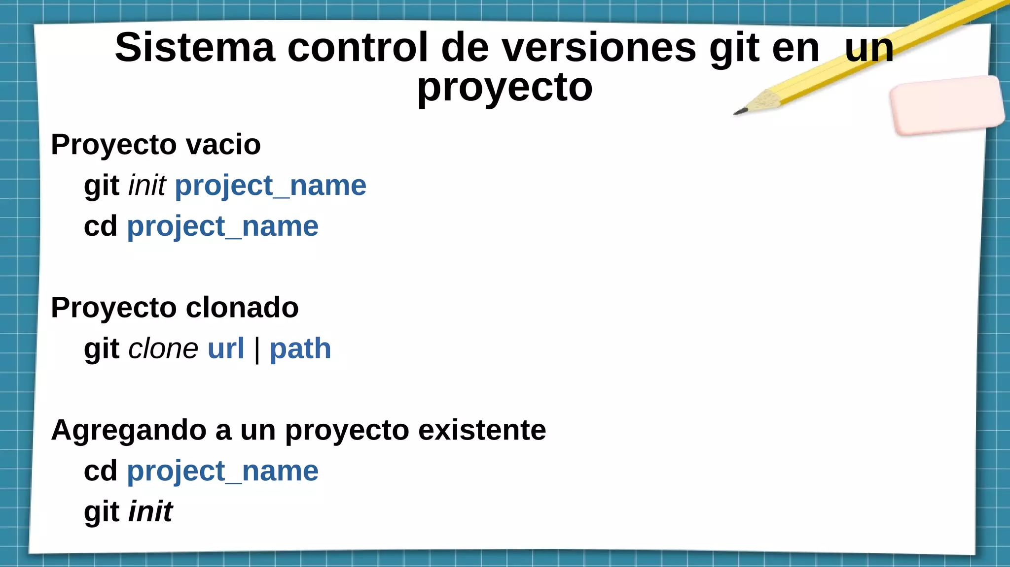

Slide 6
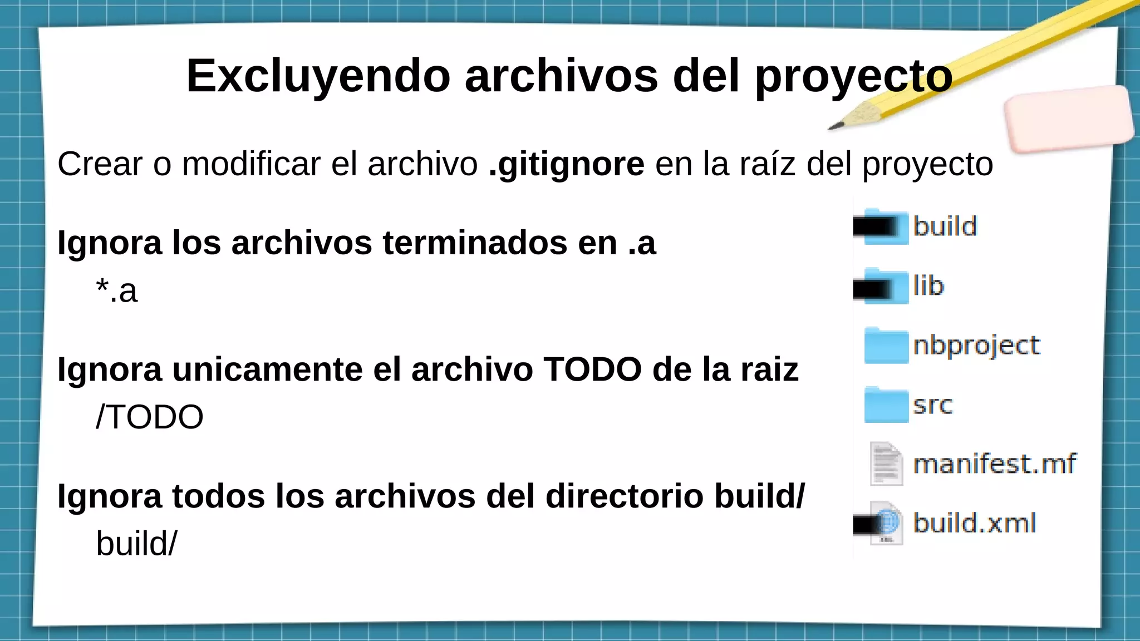

Slide 7
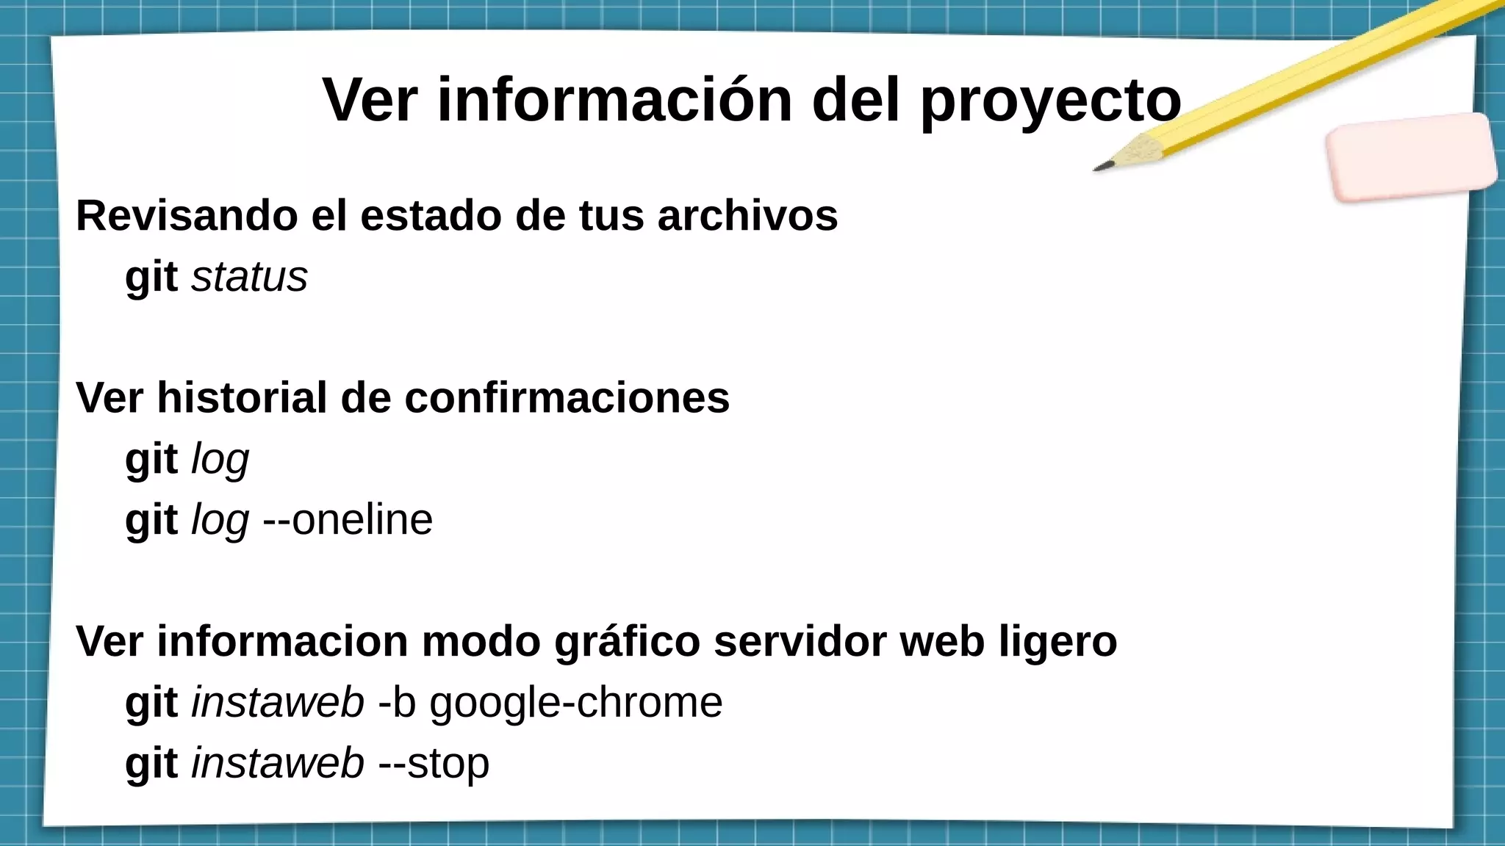

Slide 8
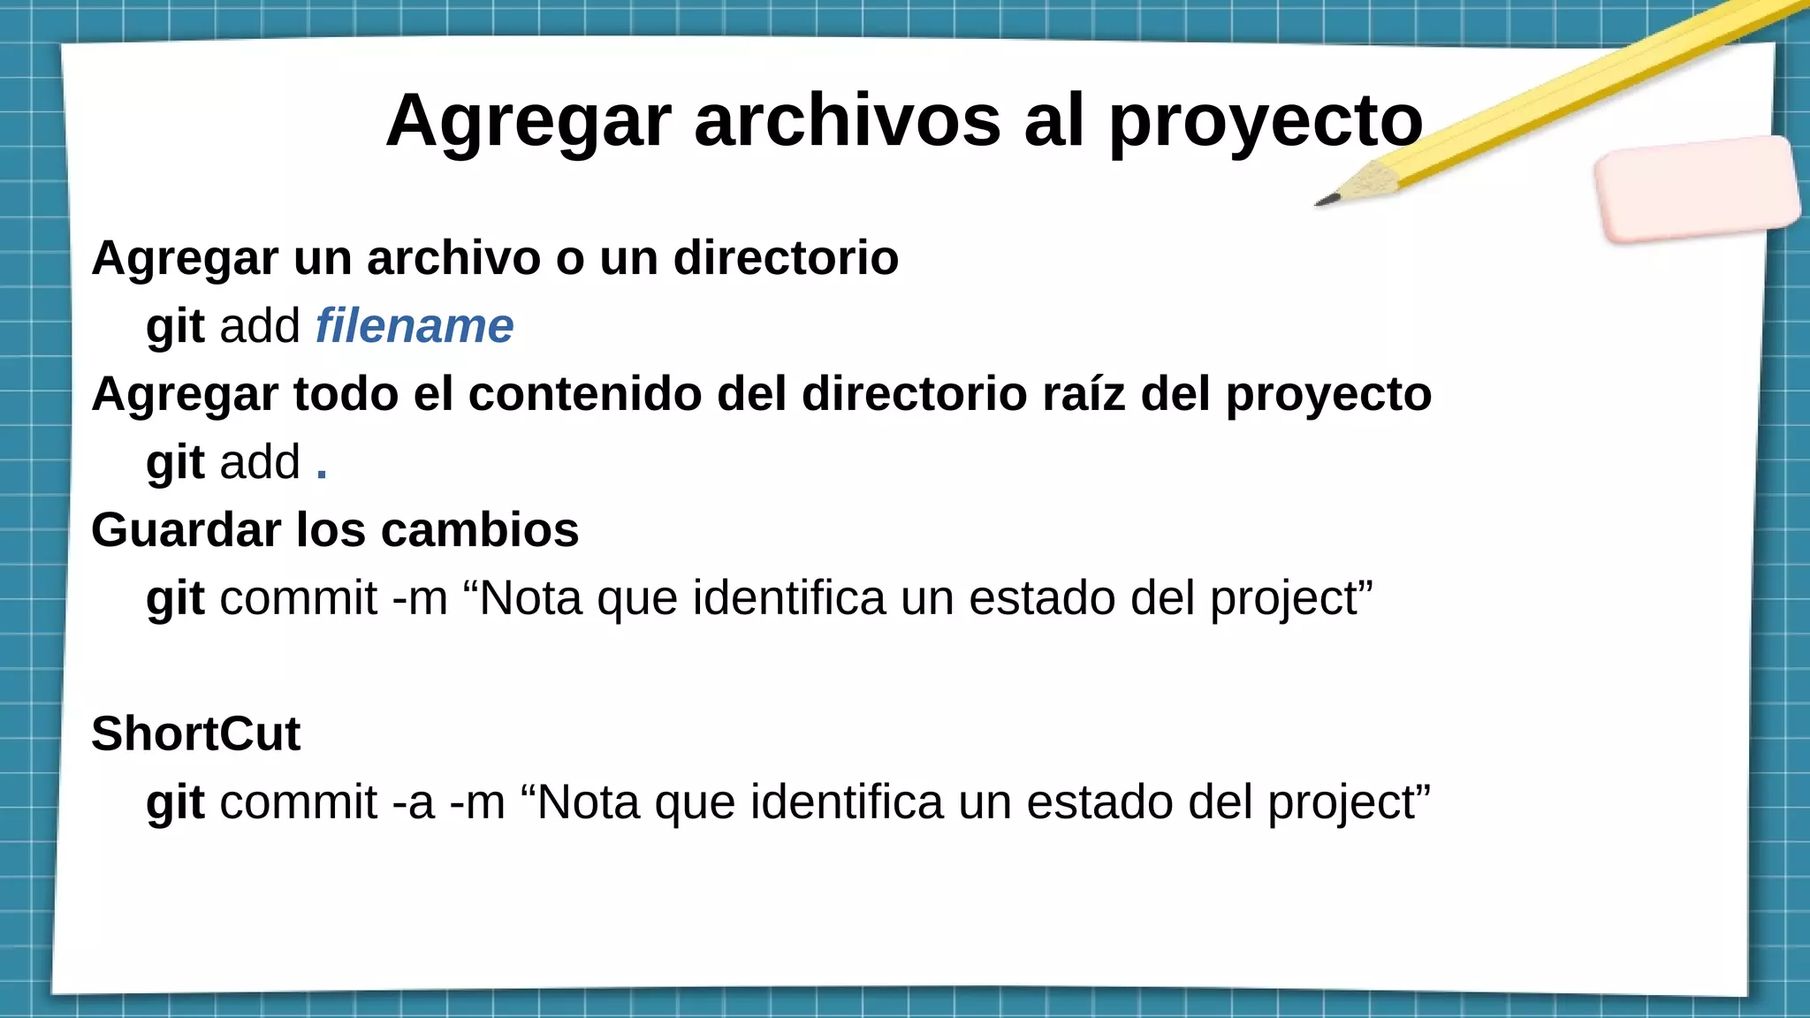

Slide 9
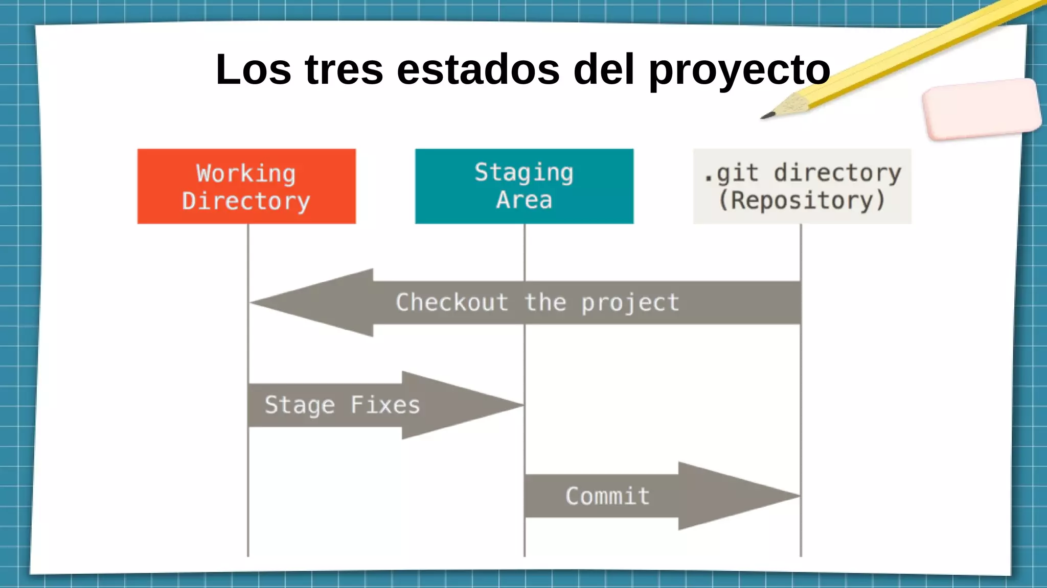

Slide 10
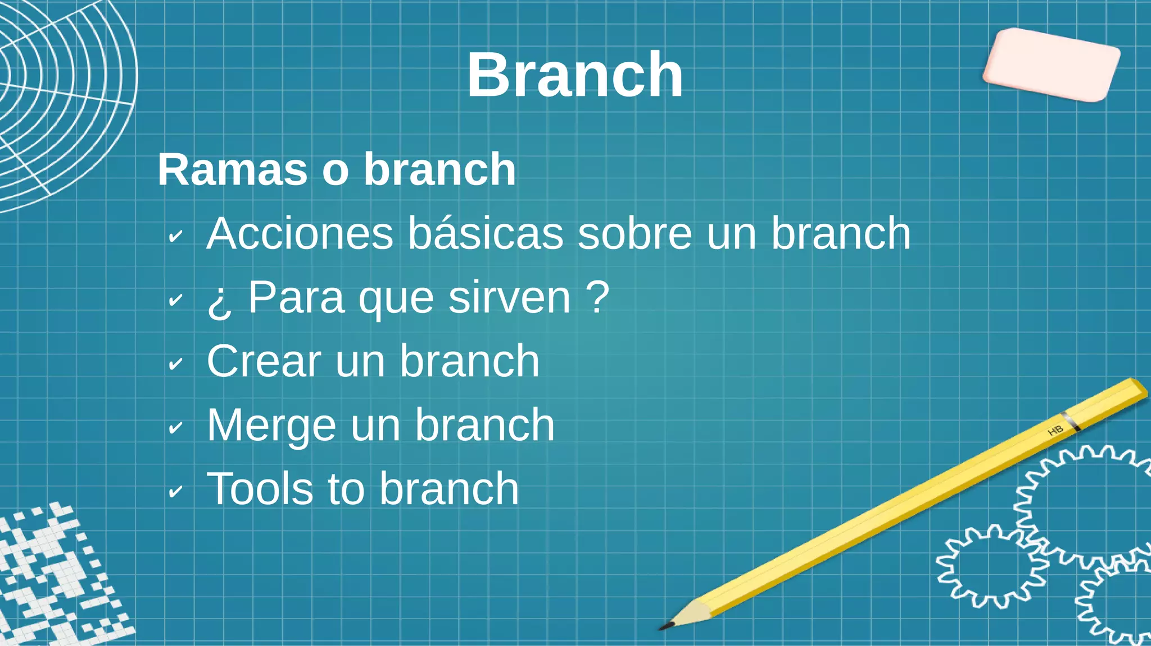

Slide 11
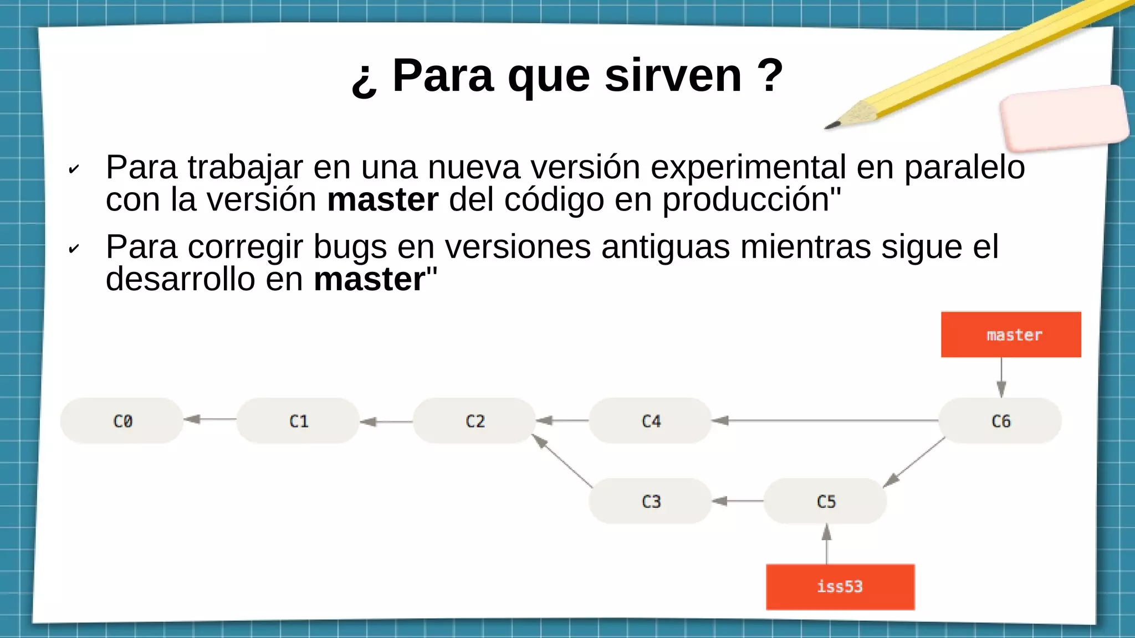

Slide 12
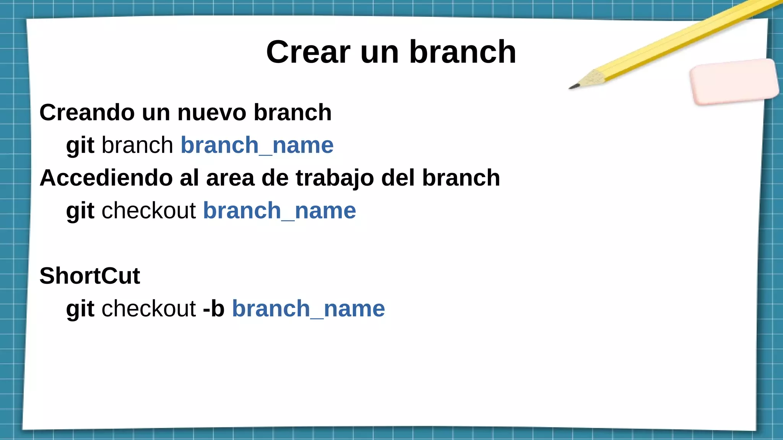

Slide 13
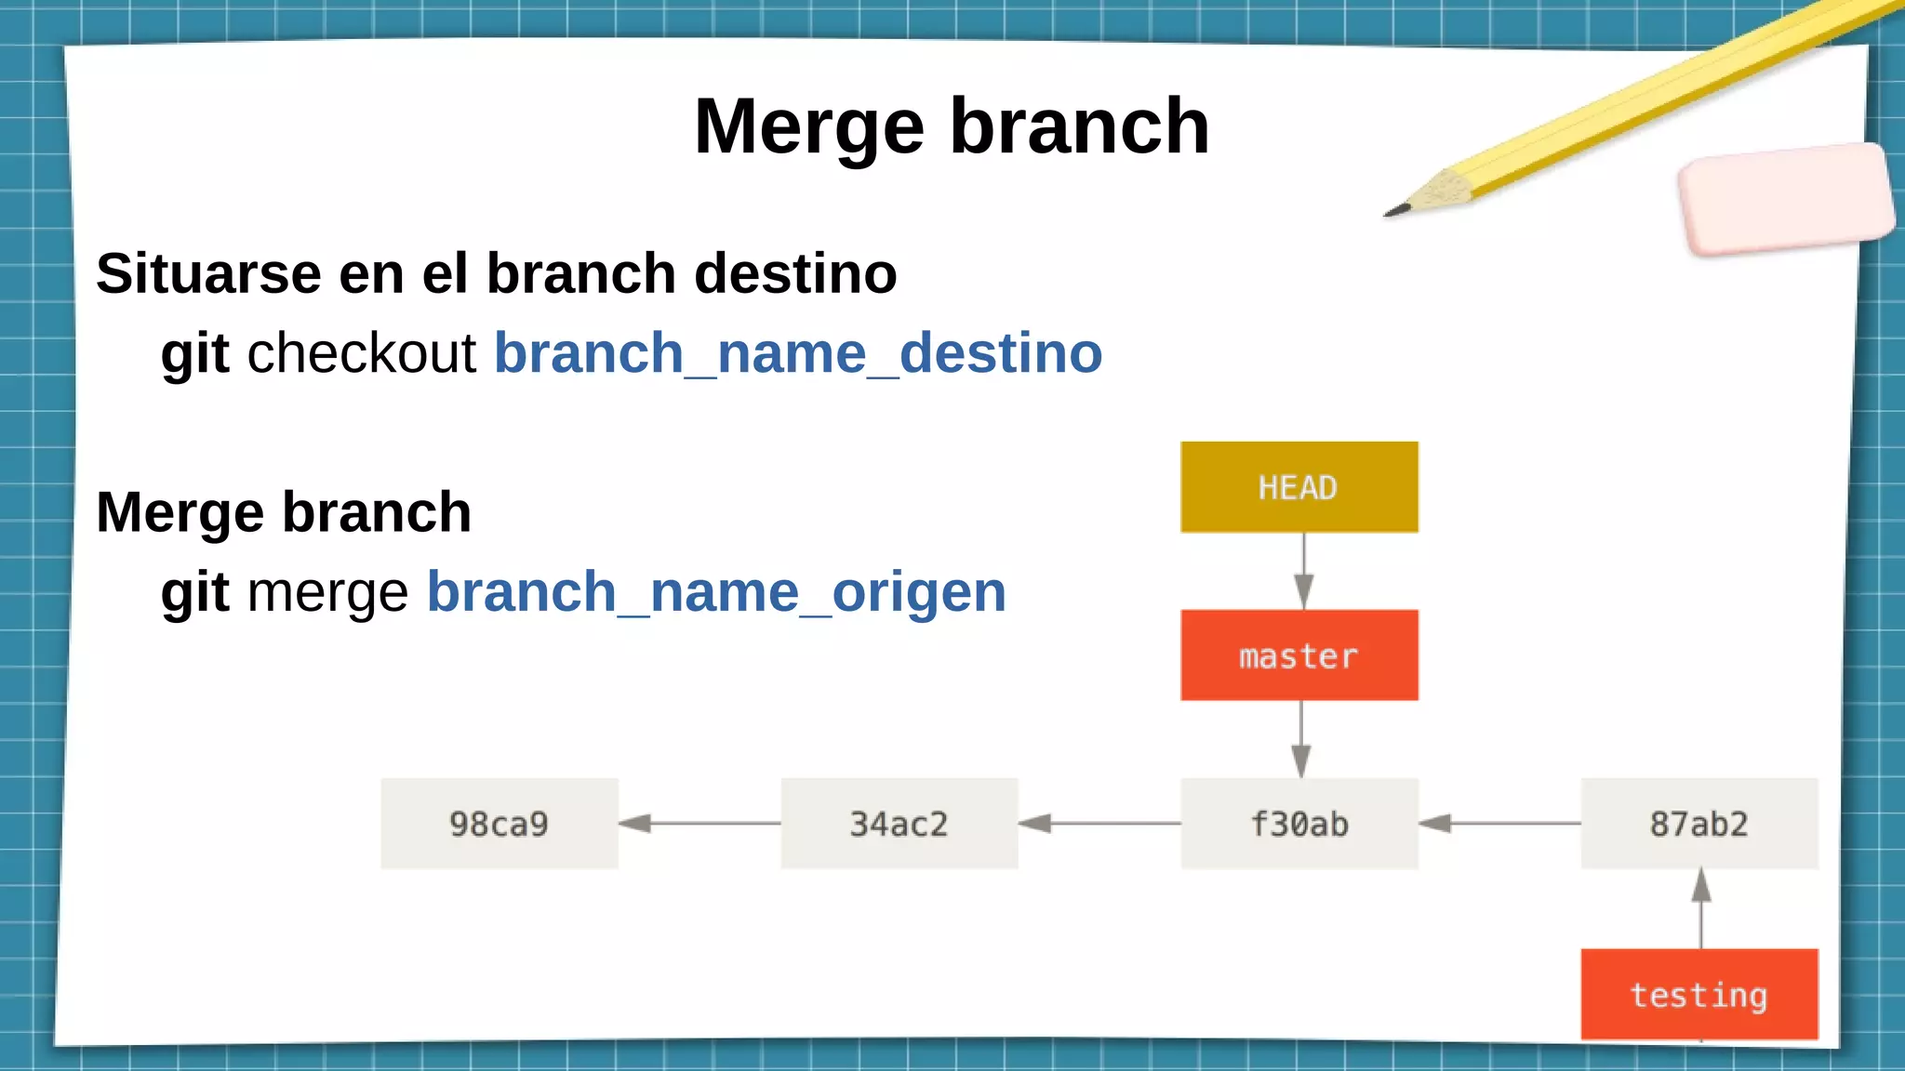

Slide 14
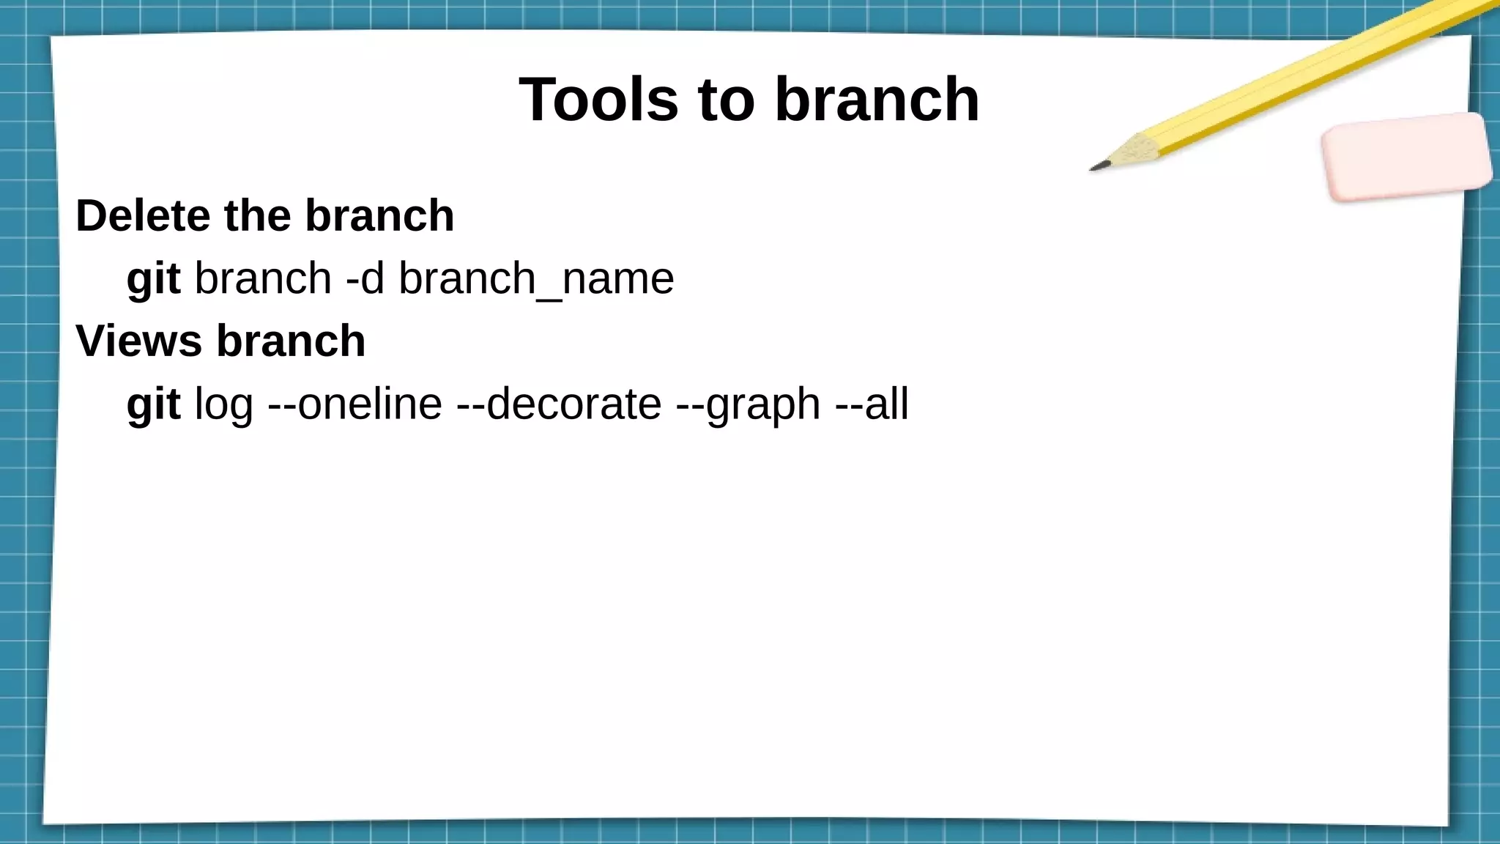

Slide 15
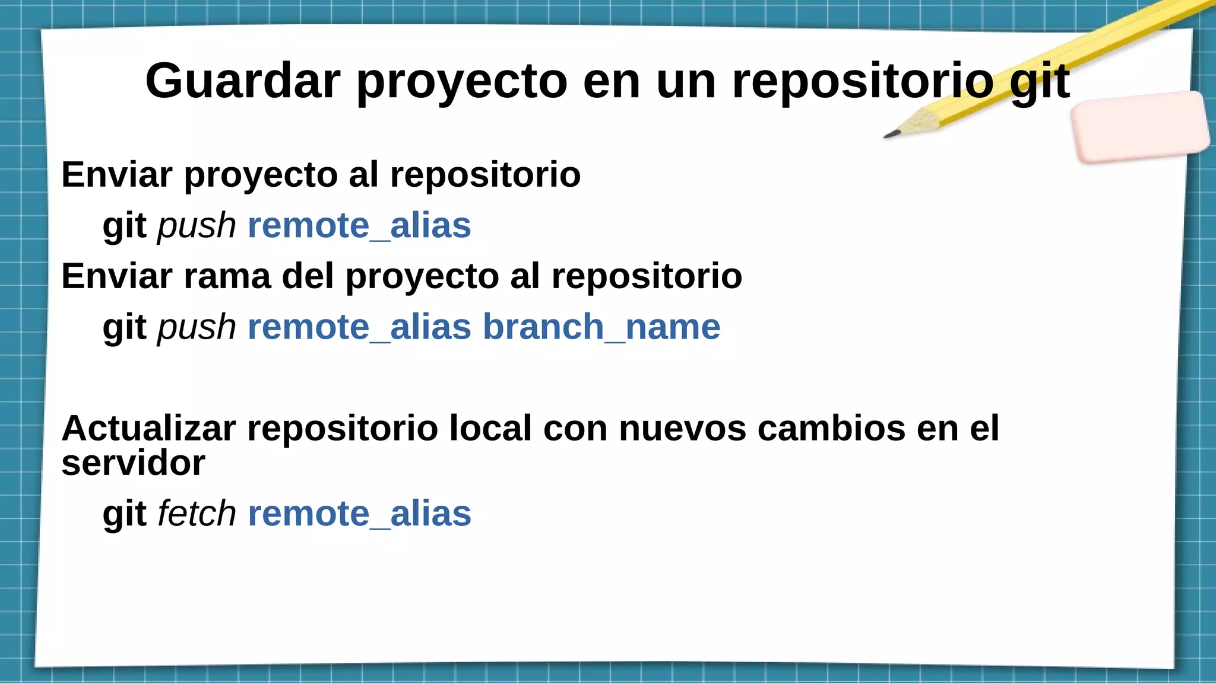

Slide 16

git init @ Alice
HEAD
(Alice)
master
c0

Slide 17
git commit @ Alice
HEAD
(Alice)
master
c0
c1

Slide 18
git tag @ Alice
HEAD
(Alice)
master
v0.1
c0
c1

Slide 19
git commit @ Alice
HEAD
(Alice)
v0.1
master
c0
c1
c2

Slide 20
git clone @ Bob
HEAD
(Bob)
HEAD
(Alice)
v0.1
master
c0
c1
c2

Slide 21
git branch @ Bob
HEAD
(Alice)
v0.1
master
c0
c1
c2
mult
HEAD
(Bob)

Slide 22
git commit @ Bob
HEAD
(Alice)
v0.1
master
c0
c1
c2
c3
mult
HEAD
(Bob)

Slide 23
git commit @ Alice
HEAD
(Alice)
master
v0.1
c4
c0
c1
c2
c3
mult
HEAD
(Bob)

Slide 24
git commit @ Alice
HEAD
(Alice)
master
v0.1
c4
c5
c0
c1
c2
c3
mult
HEAD
(Bob)

Slide 25
git commit @ Bob
HEAD
(Alice)
master
v0.1
c4
c5
c0
c1
c2
c3
c6
mult
HEAD
(Bob)

Slide 26
git merge @ Alice
HEAD
(Alice)
v0.1
master
c4
c5
c0
c1
c2
c7
c3
c6
mult
HEAD
(Bob)

Slide 27
git checkout master @ Bob
HEAD
(Alice)
HEAD
(Bob)
v0.1
master
c4
c5
c0
c1
c2
c7
c3
c6
mult

Slide 28
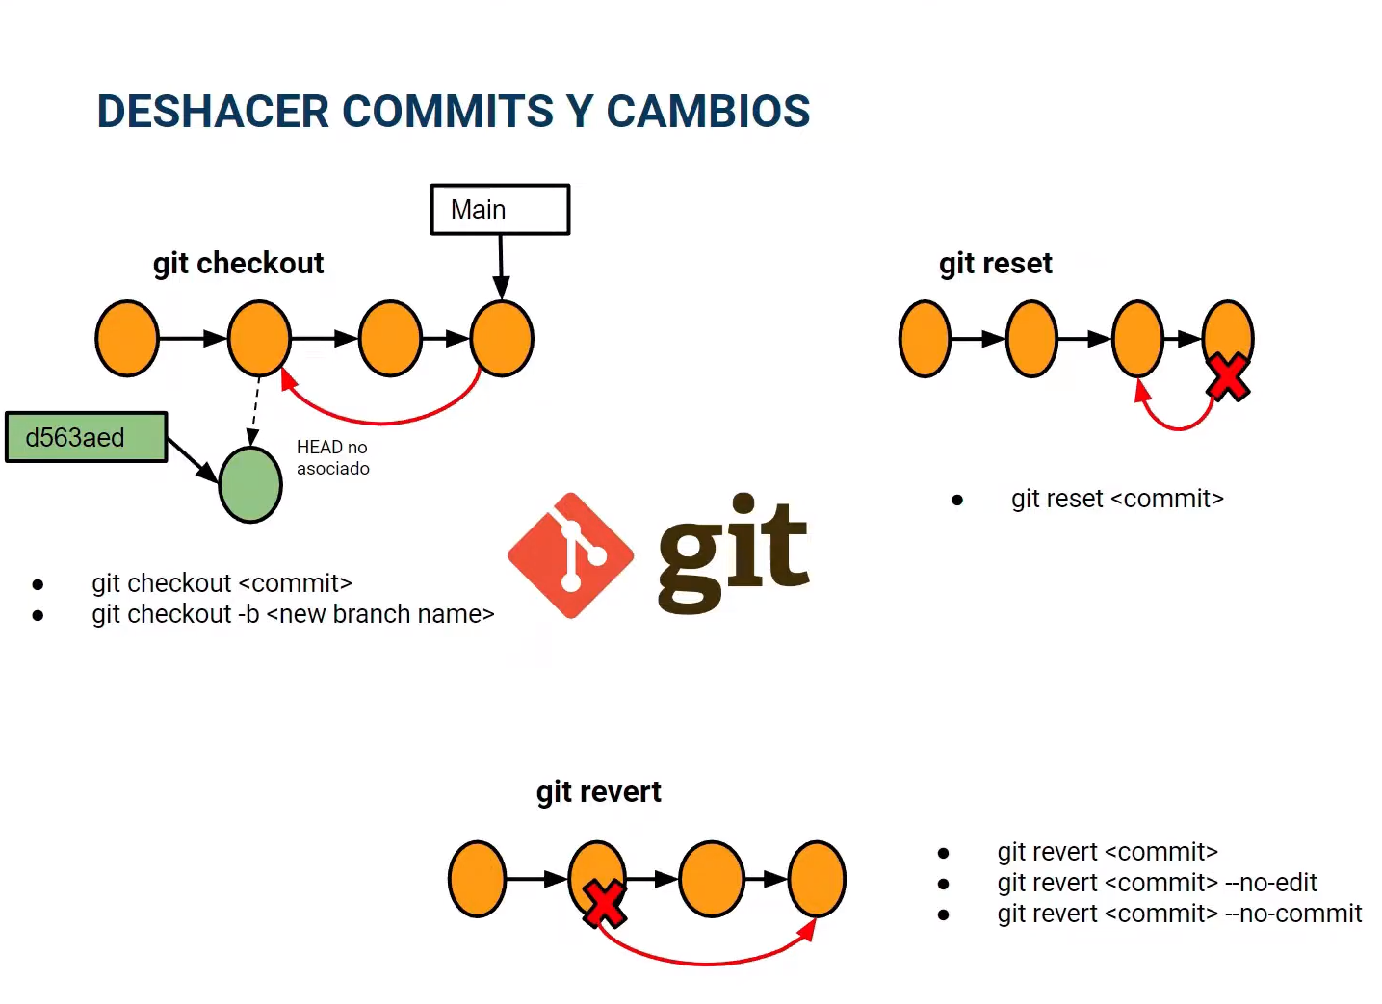

Slide 29
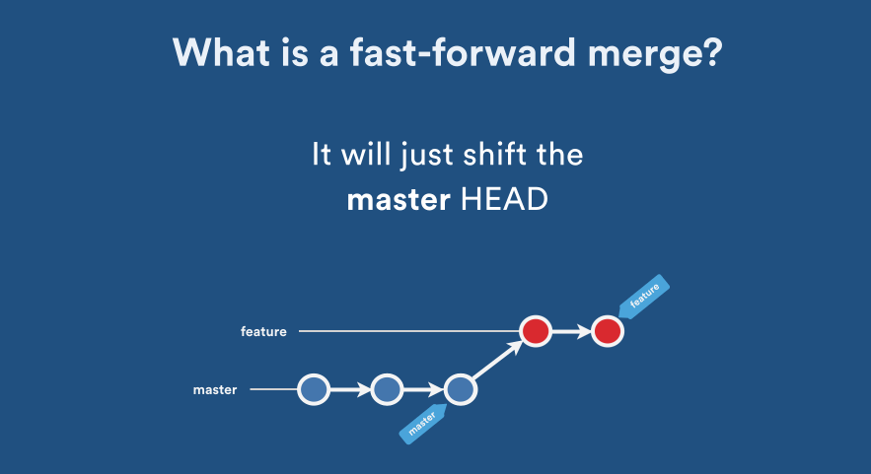
Tipos de merge fast forward

Slide 30
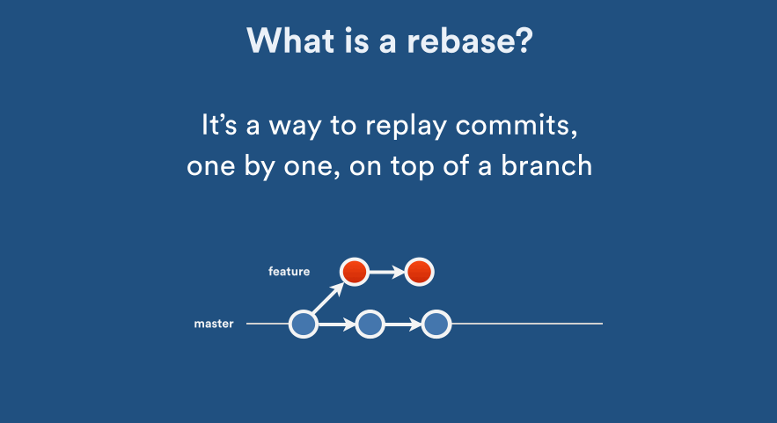
Tipos de merge rebase

Slide 31
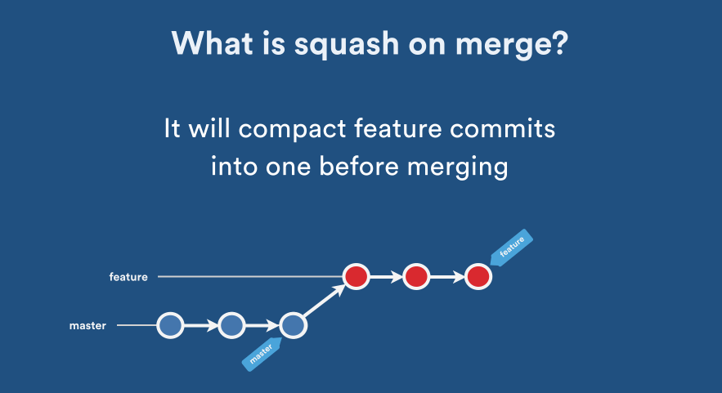
Tipos de merge squash

Slide 32
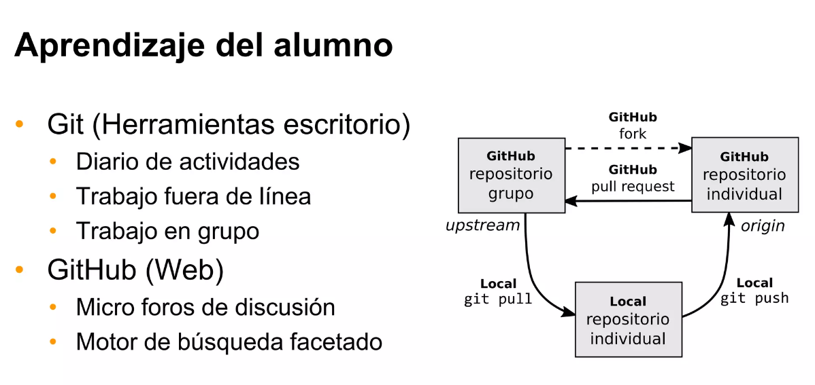
RESUMEN

Slide 33
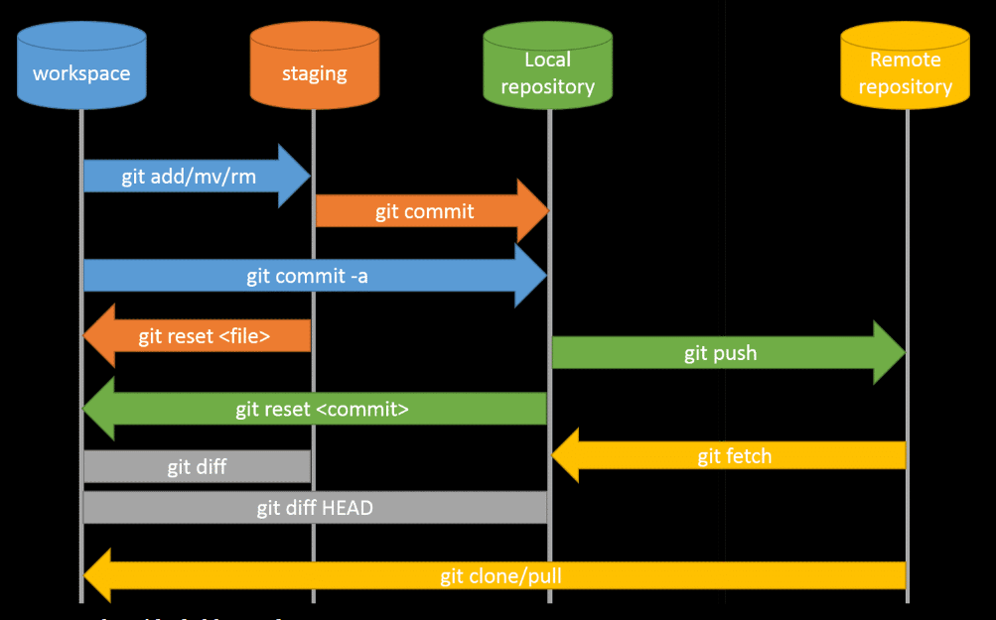

Slide 34
RESUMEN
¿Qué necesitamos? Iniciar repositorios
Clonar repositorios
Ramificación y fusión
Sincronización con repositorios remotos
Gestión de conflictos
Etiquetado de versiones
Revertir cambios

Slide 35


